Slide 1
Electric Circuits
Dr. Muawia Mahmoud
mamahmoud@fbsu.edu.sa

Slide 2
Text book, and references
C.L Wadhwa, Basic Electrical Engineering, New age publishing, 2007
Charles J. Alexander, Sadiku, Fundamentals of Electric Circuits, 4th, McGraw-Hill, 2009

Slide 3
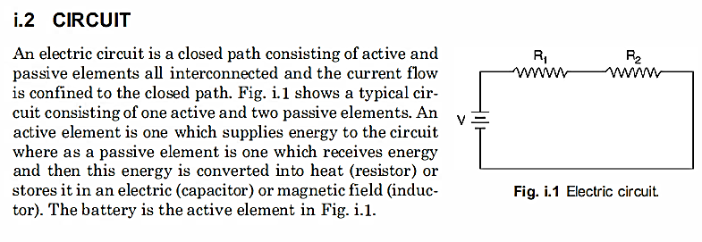
DC Circuits

Slide 4
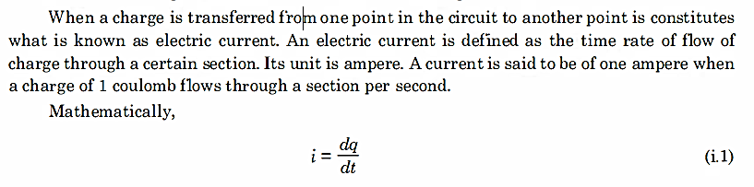

ELECTRIC Current CURRENT
Charge Q = I*t coulomb (C)

Slide 5

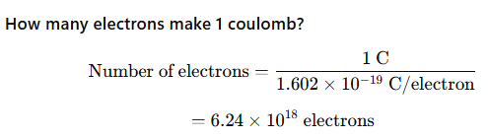

Slide 6
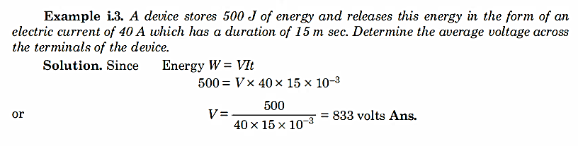
Energy W = V*l*t joule

Slide 7

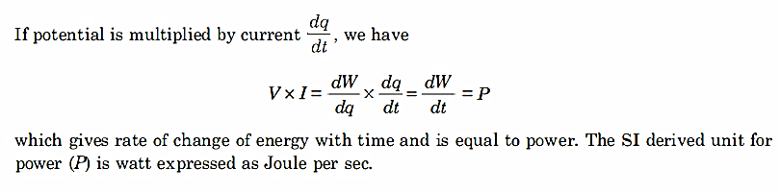

Slide 8
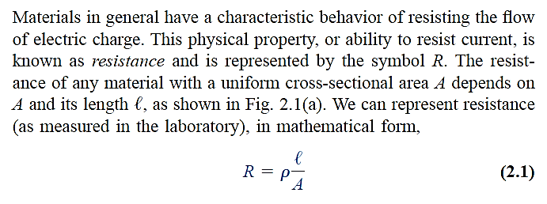
Resistance

Slide 9
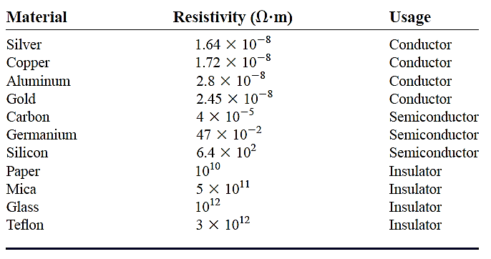

Slide 10

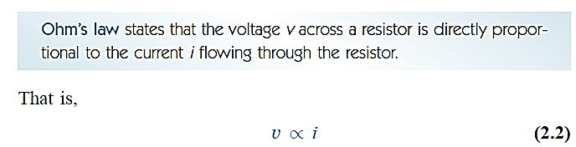


Slide 11
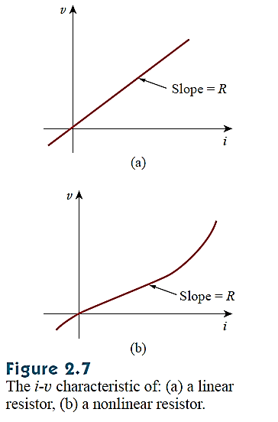

Slide 12
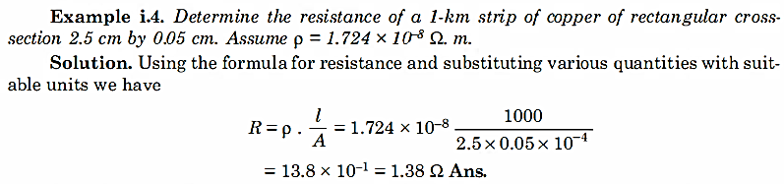

Slide 13
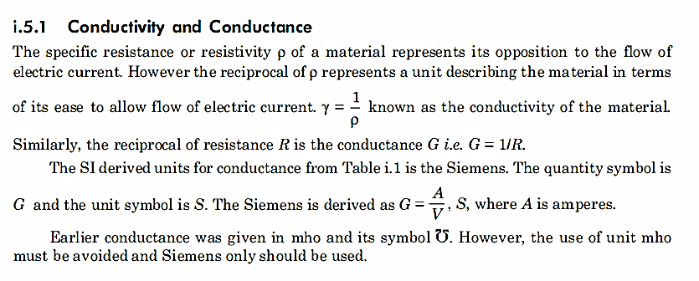

Slide 14
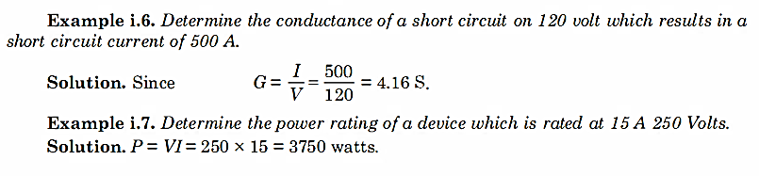

Slide 15



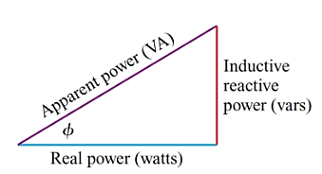

Real Power, Apparent and Reactive powers (AC)
Efficiency is calculated using Real Power: (Watt/Watt)
In Watt

Slide 16

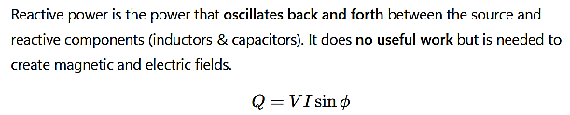


Slide 17
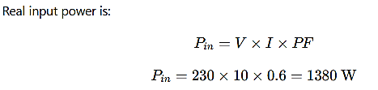

An electric motor is connected to a 230 V supply.
Line current = 10 A
Power factor = 0.6 lagging
Mechanical output power = 1,100 W

Slide 18

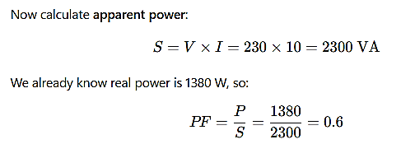
Watt/VA = Real/Apparent

Slide 19
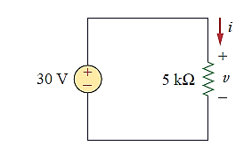
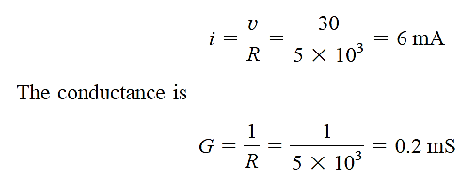
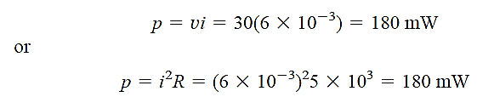
Example (DC)
calculate the current i, the conductance
G, and the power p.

Slide 20
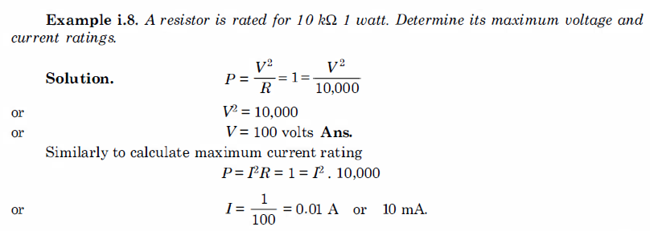

Slide 21
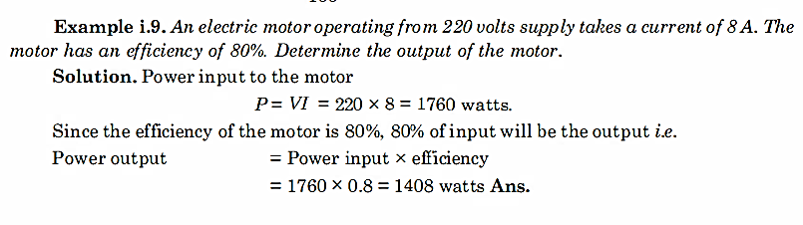
with PF = 1

Slide 22
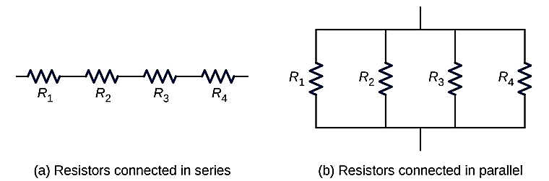


Resistors Connections

Slide 23
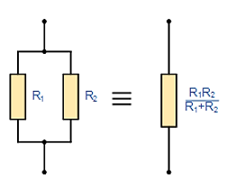
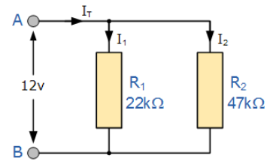


Slide 24
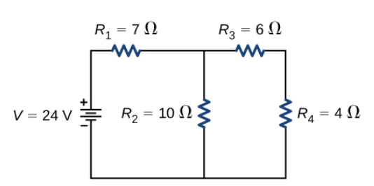
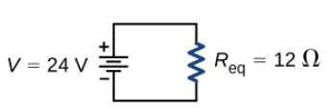

Slide 25
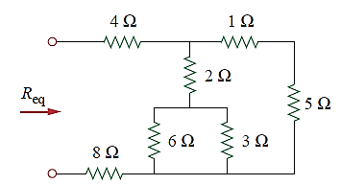

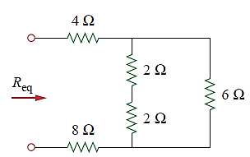


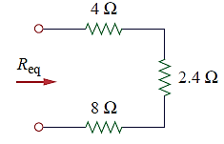


Slide 26
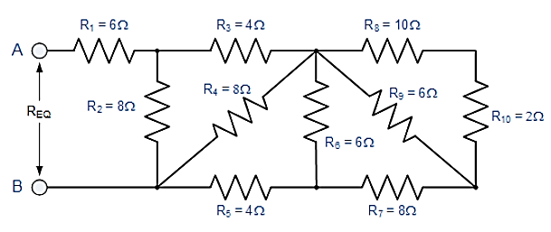
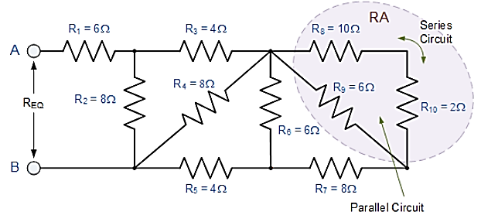

Find Req.
Starting from the right hand side and using the simplified equation for two parallel resistors, we can find the equivalent resistance of the R₈ to R₁₀ combination and call it R_{A}.

Slide 27
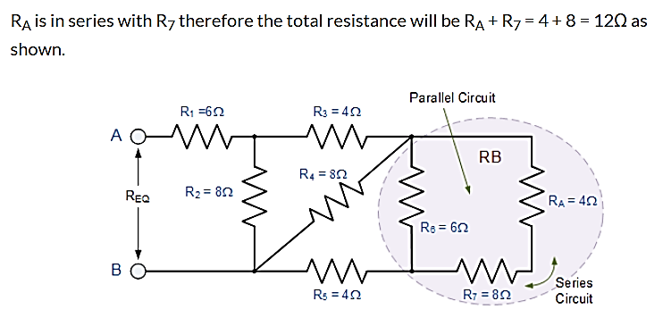
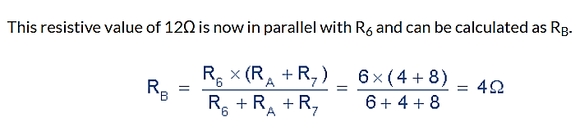

Slide 28
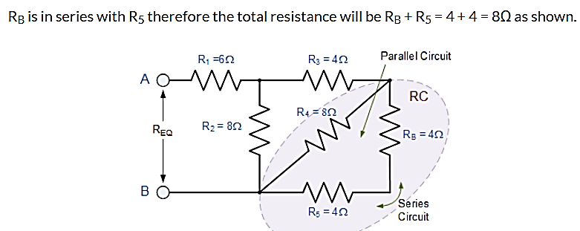
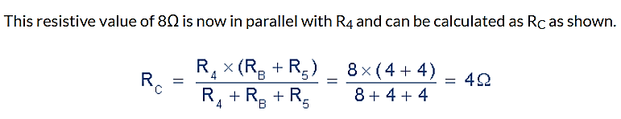

Slide 29
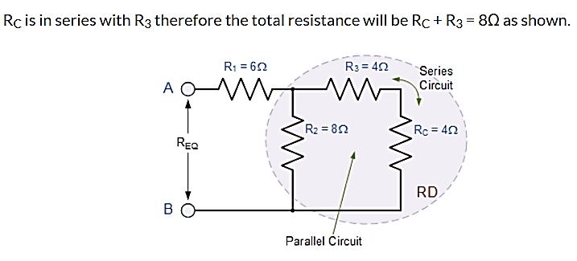
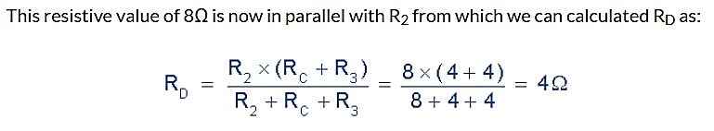

Slide 30
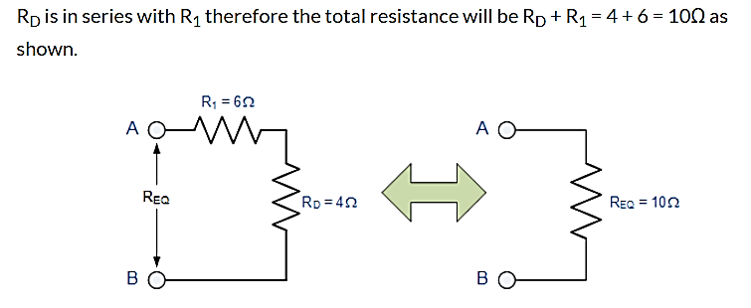

Slide 31
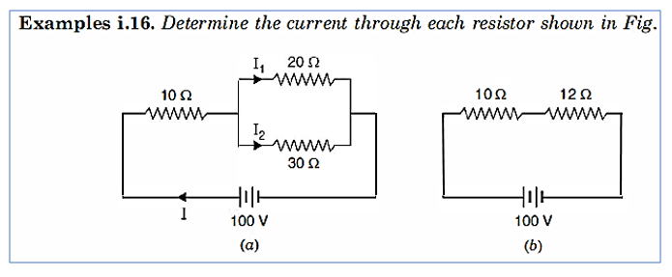

Slide 32
